Slide 1


AR Create with Swift Playground
Presented by DHS Programming Club
Meetings Tuesdays 7:10 G208
Hour of Code 2019
Notes:
This activity requires your school iPads, if you do not have your school iPads take a moment to get in groups of 2 or 3 with those who do.

Slide 2
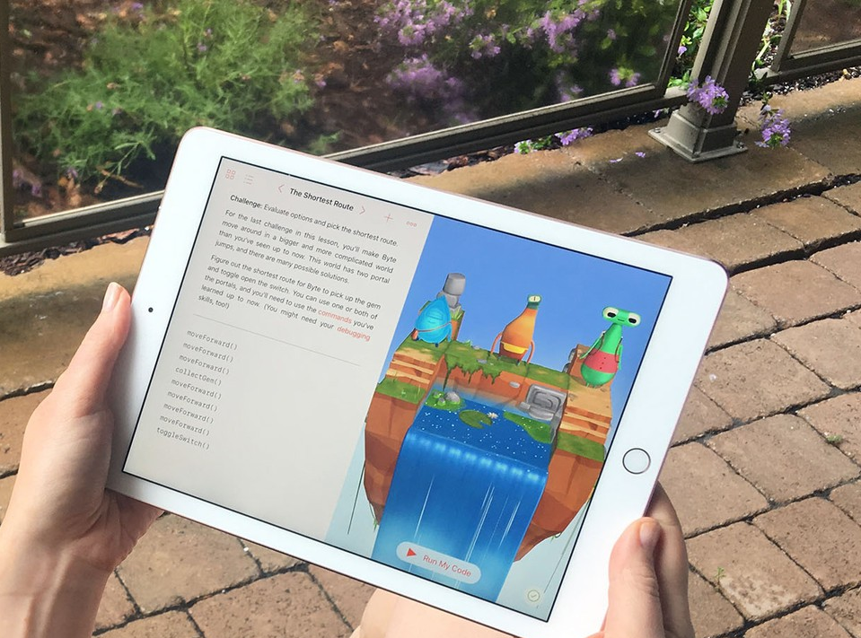
Swift Playground?
Swift Playground runs on your school iPads
Swift Playground is designed by Apple to make it possible for everyone to code
Swift Playground uses the Swift Programming Language, the same language used to develop iOS apps
Notes:
Check your ipad to see if swift playground has been installed . The icon looks like this Points at icon. If it has not already installed you can find it in self services.

Slide 3
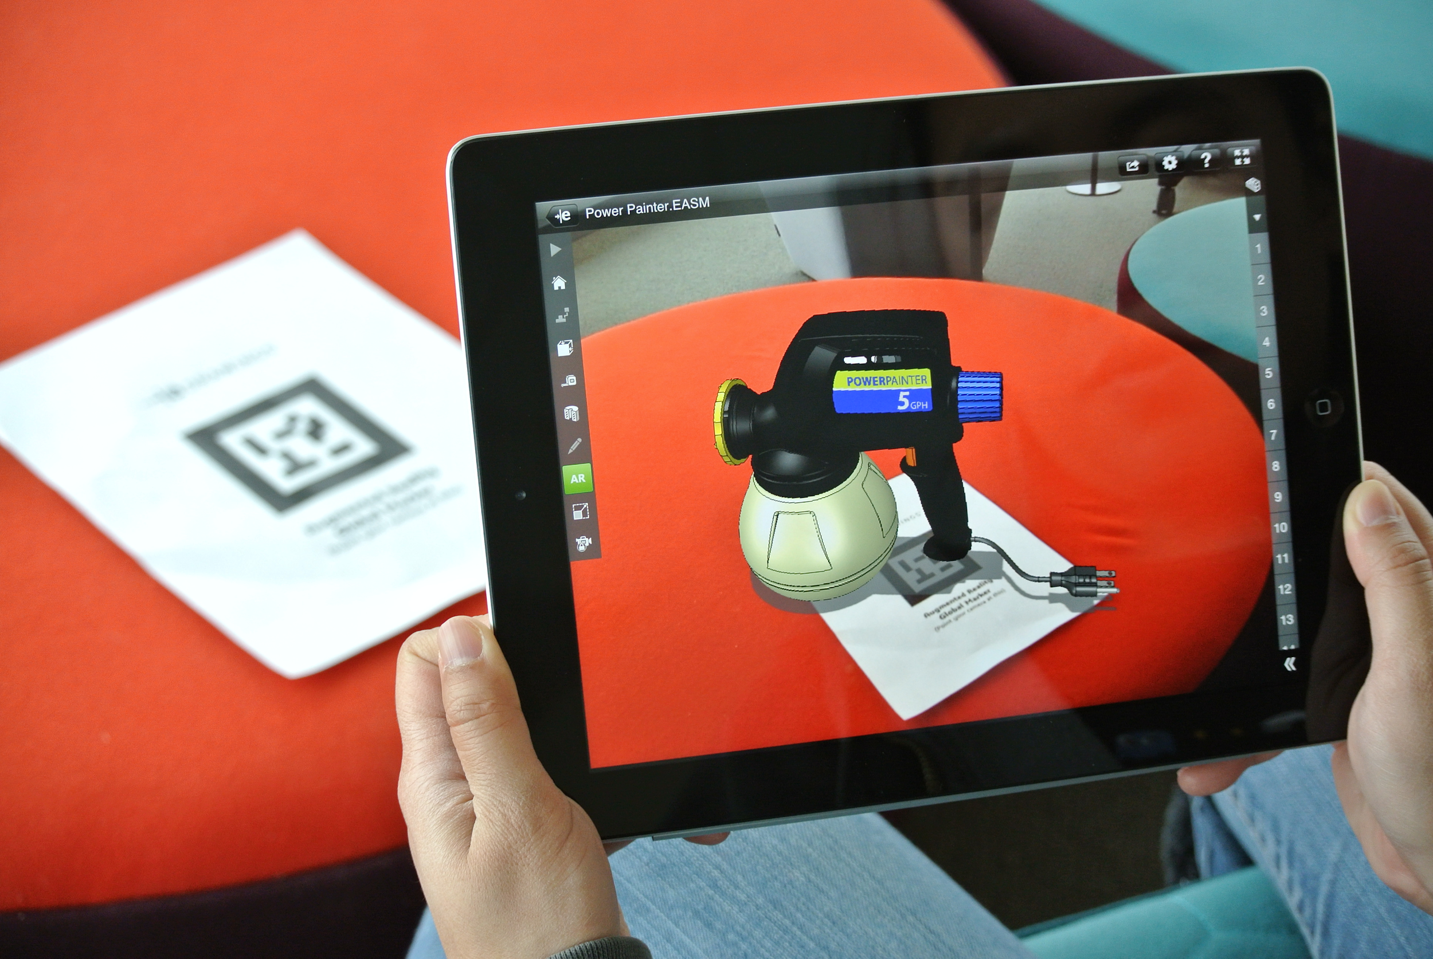
What is Augmented Reality?
Augmented Reality uses your iPads HD Camera and complex sensor array to blur the line between virtual and real by drawing 3D images on the real world. It lets you try out ideas, solve problems and share what you envision with others.
Notes:
AR stands for augmented reality. Augmented Reality uses your iPads HD-Camera and complex sensor array to blur the line between virtual and real by compositing 3D images on the real world. It lets you try out ideas, solve problems and share what you envision with others. AR is a tool that everyone will find useful. The ipad is uniquely suited for AR and the app Swift Playground’s AR Create makes learning it possible for everyone, AR create is also an open ended program, which means that once you learn you can be creative without limits.

Slide 4
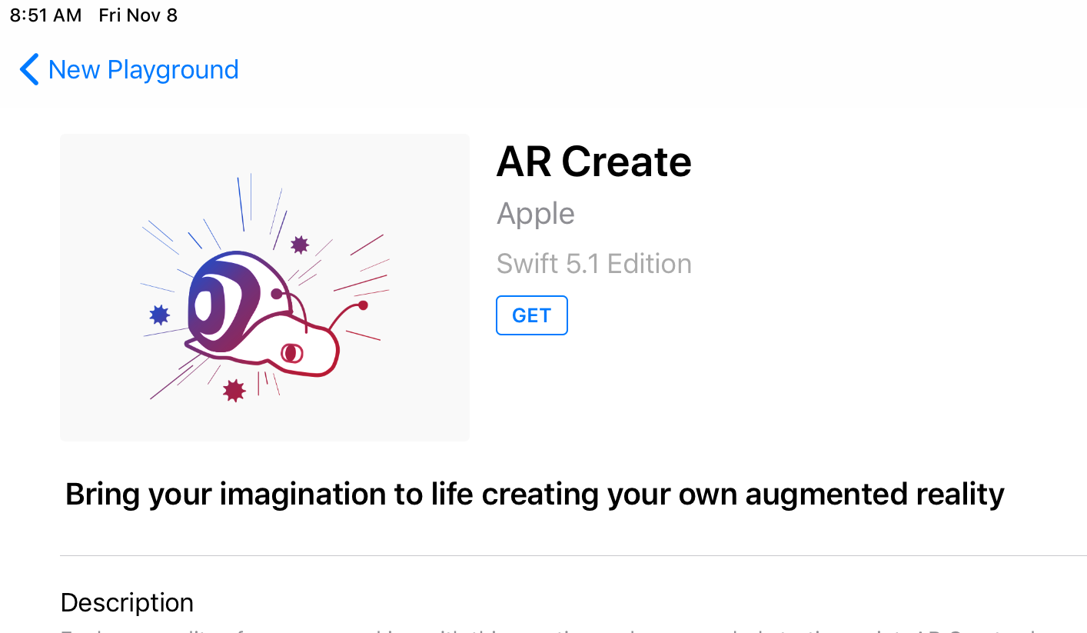
Installing AR Create
Swift Playground has many different projects that you can use to learn coding
We will be using AR Create
AR Create uses Apple’s AR Kit to allow you to easily composite 3D models onto the real world
Notes:
When you open Playground you’ll see there are alot of projects to choose from. Select AR create, and press the get button. Now that AR create is installed tap on it to open it.

Slide 5
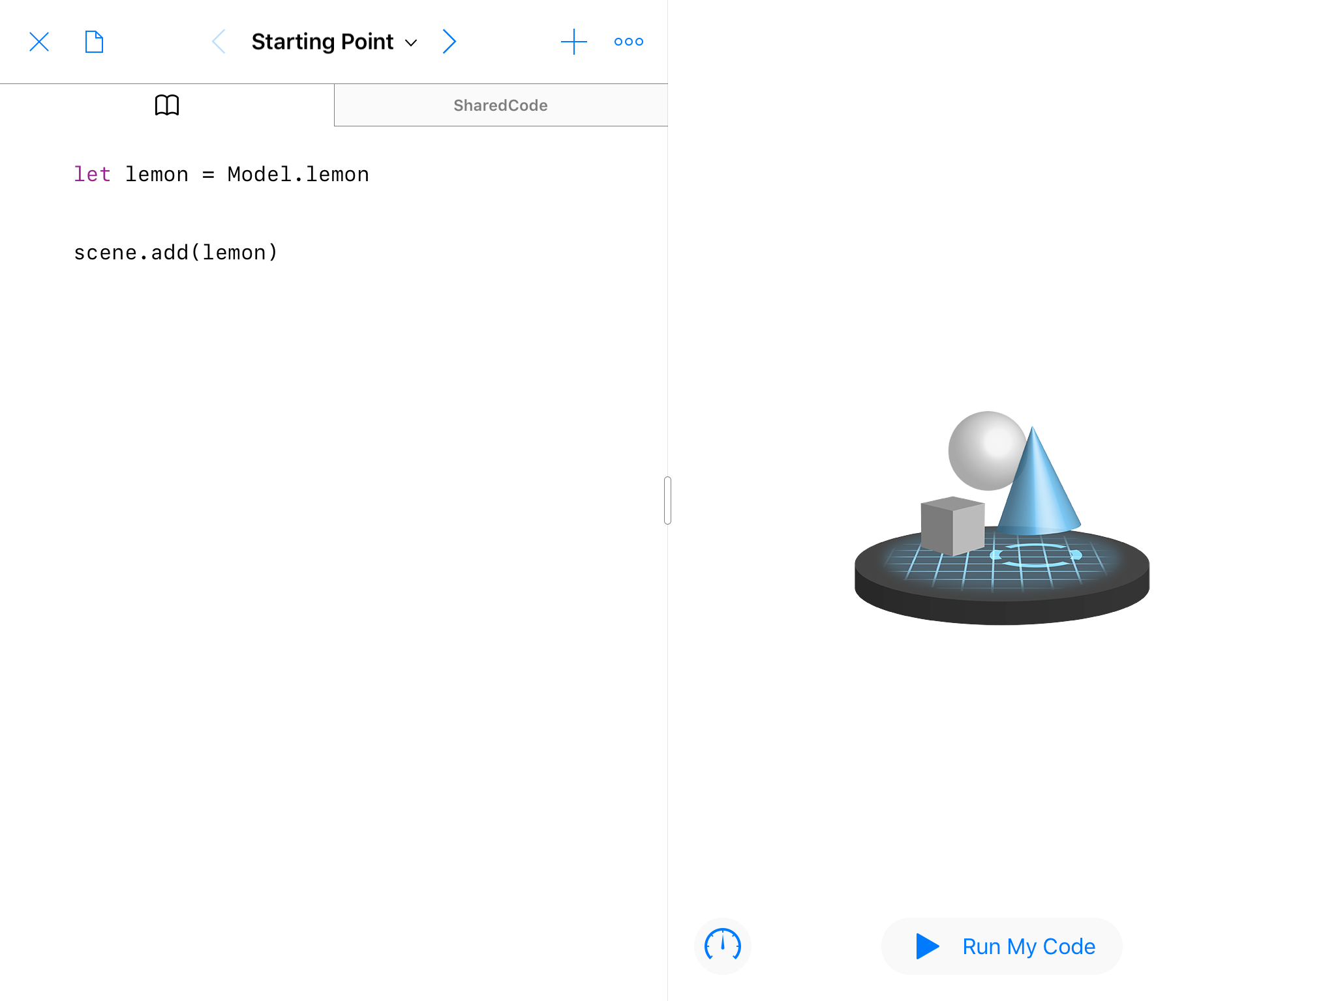
Getting Started with AR Create
Create your models (variables)
let {name} = Model.{model}
scene.add({name})
These are a couple of the objects you can create : sun, moon, and star
Notes:
You are now at the main page of AR Create. The first thing to do is to create a model. We can create many different kinds of models, but for now we will be creating either a moon, sun, or star, to create a star we must declare a variable, so first we put
let next we put the name of the variable, in this case I will call it model. Finally put = model.Star
So the completed code is: let model = model.Star (please note that this code is cap sensitive)
Finally we have to add the model to our scene.
scene.add(model)

Slide 6
Getting Started with AR Create
Create your models (variables)
let {name} = Model.{model}
scene.add({name})
These are a couple of the objects you can create : sun, moon, and star
let star = Model.star
scene.add(star)
Notes:
You are now at the main page of AR Create. The first thing to do is to create a model. We can create many different kinds of models, but for now we will be creating either a moon, sun, or star, to create a star we must declare a variable, so first we put
let next we put the name of the variable, in this case I will call it model. Finally put = model.Star
So the completed code is: let model = model.Star (please note that this code is cap sensative)
Finally we have to add the model to our scene.
scene.add(model)

Slide 7
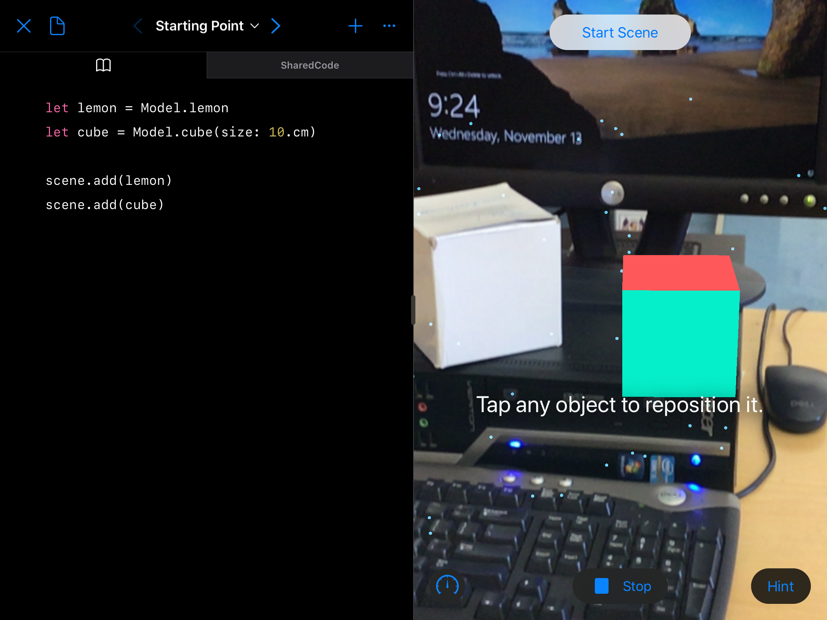
Creating Shapes
In order to create a shape you have to specify some parameters, such as size:
let {name} = Model.cube(size: 5.cm)
let {name} = Model.sphere(size: 10.cm)
scene.add({name})
Picture of AR Create with some created shapes
Notes:
Next we will be creating shapes. While models are premade, shapes need to be made by you, in order to do this you need to specify parameters. For now we will be focusing on cubes and spheres as they have only one parameter, size, however later on you can create different shapes that might have more.
The first part of creating a shape is much like creating a model. Declare your variable. Mine is named cubify
let cubify = Model.cube(
But now we have to specify our parament, size, in this case my cube is 12cm
let cubify = Model.cube(size: 12.cm)
Now you can add your cube to the scene
scene.add(cubify)
You can do the same thing with a sphere: in this case I named it sphere and made the size 7
let sphere = Model.sphere(size: 7.cm)
scene.add(sphere)

Slide 8
Creating Shapes
In order to create a shape you have to specify some parameters, such as size:
let {name} = Model.cube(size: 5.cm)
let {name} = Model.sphere(size: 10.cm)
scene.add({name})
Picture of AR Create with some created shapes
let cube = Model.cube(size: 5.cm)
scene.add(cube)
Notes:
Next we will be creating shapes. While models are premade, shapes need to be made by you, in order to do this you need to specify parameters. For now we will be focusing on cubes and spheres as they have only one parameter, size, however later on you can create different shapes that might have more.
The frist part of creating a shape is much like creating a model. Declare your variable. Mine is named cubify
let cubify = Model.cube(
But now we have to specify our parament, size, in this case my cube is 12cm
let cubify = Model.cube(size: 12.cm)
Now you can add your cube to the scene
scene.add(cubify)
You can do the same thing with a sphere: in this case I named it sphere and made the size 7
let sphere = Model.sphere(size: 7.cm)
scene.add(sphere)

Slide 9
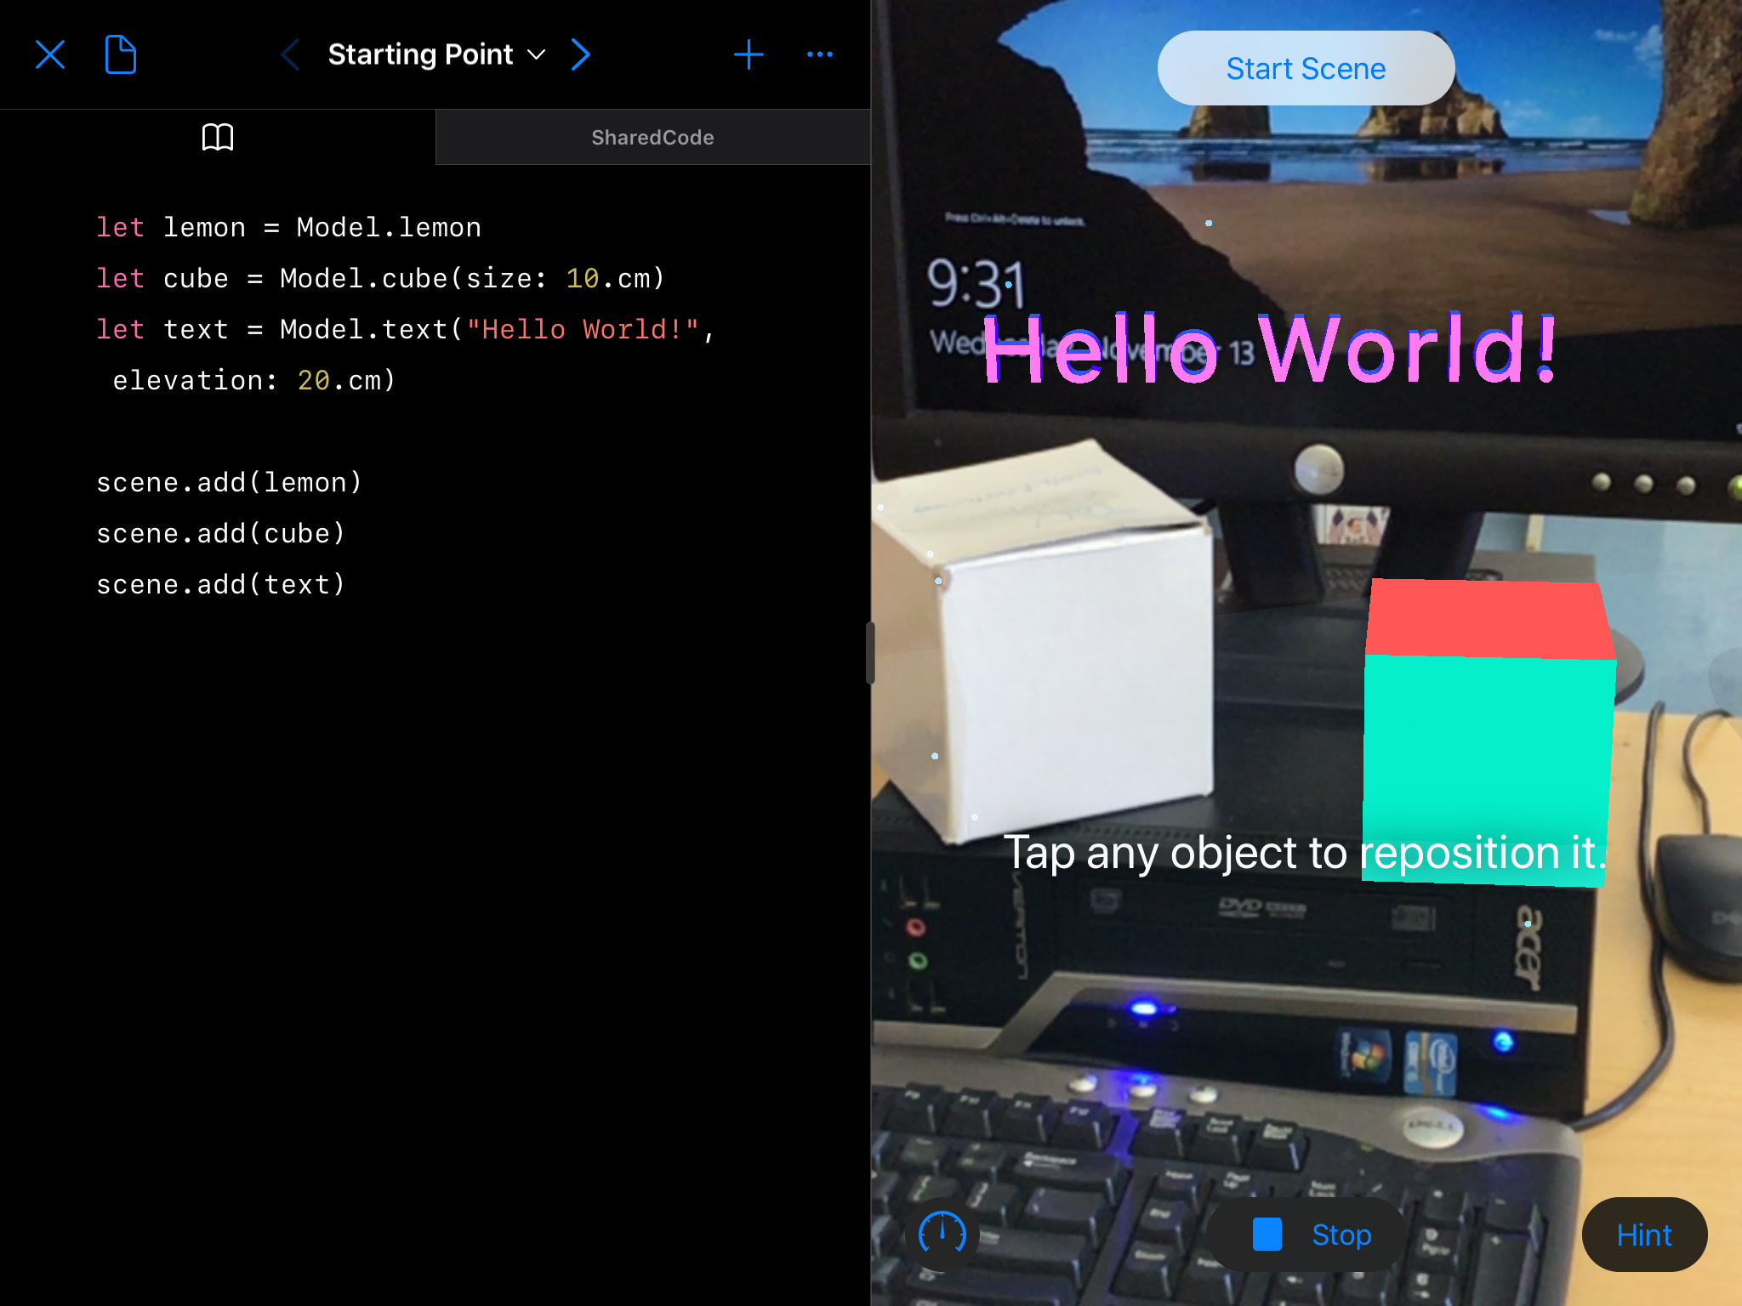
Adding Text
The text field has two parameters, the text and the elevation.
let {name} = Model.text(“sometext”, elevation:20.cm)
scene.add({name})
Picture of AR Create with some text
Notes:
Finally we will be creating text. Text has two parameters, the text and the elevation.
let hello = Model.text(“Hello World!”, elevation:5.cm)
scene.add(hello)

Slide 10
Adding Text
The text field has two parameters, the text and the elevation.
let {name} = Model.text(“sometext”, elevation:20.cm)
scene.add({name})
Picture of AR Create with some text
let text = Model.text(“Hello World!”, elevation: 20.cm)
scene.add(text)
Notes:
Finally we will be creating text. Text has two parameters, the text and the elevation.
let hello = Model.text(“Hello World!”, elevation:5.cm)
scene.add(hello)

Slide 11
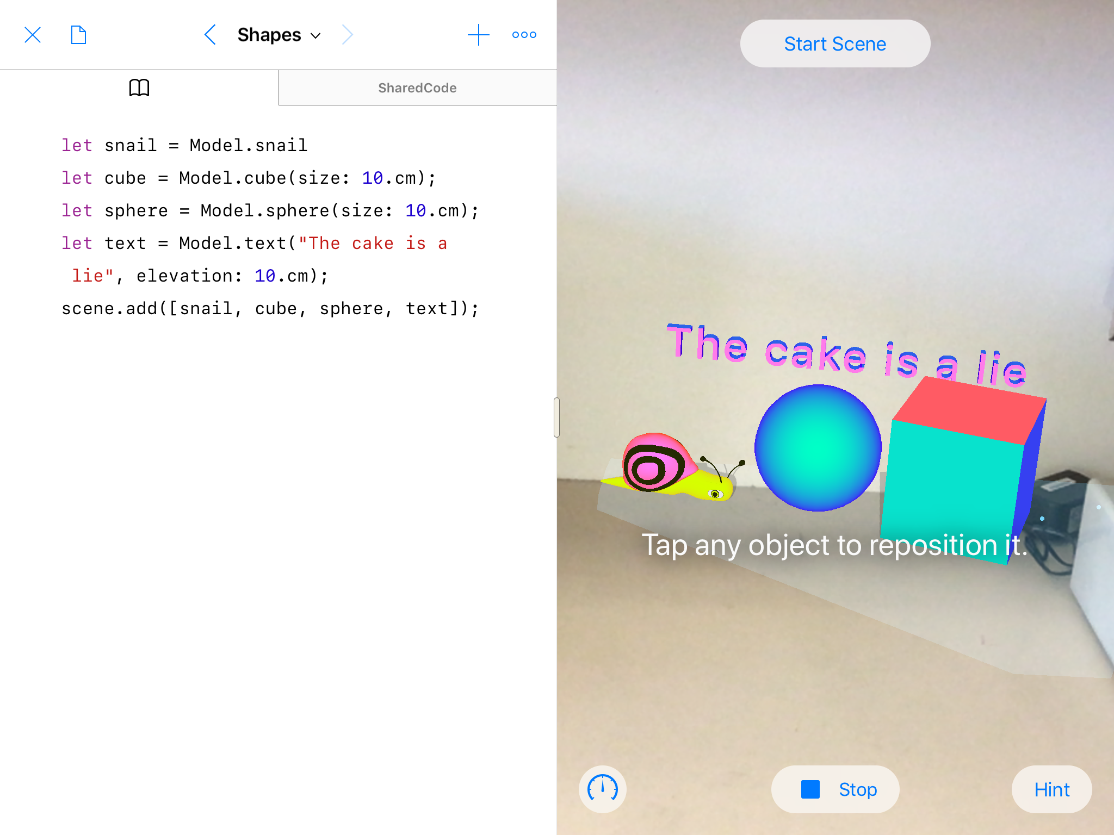
Build your own AR Demo
Use what you learned to create own use scene in AR.
See a quick reference sheet at hoc.dhsprogramming.com or get more info at the API Demo tab
Be creative. Have fun. Code
Notes:
Now that we have learned the basics of Swift Playground you can create your scene. Try to tell a story and have fun with it. You can see a list of all the models and shapes and how to use them at the quick reference page at hoc.dhsprogramming.com

Slide 12
Credits:
Slides and Script: Toby Cowles
Audio: Stephen Kletter
Documentation: John /Toby Cowles
Video: Toby Cowles
Thanks to all our programming club members and everyone else who helped make this happen!

